Slide 1


HACK IT’22 Project Presentation CODE GLEAM
KANYARASHI ----- 34

Slide 2
Team Members
01
Name 1
02
Name 3
03
Name 2
04
Name 4
Ch.Nikithanjali
M.Laxman Sai Prakash
P.Shivamani
P.Sneha anjali

Slide 3
ED Tech
Create a mobile app, web app, or hybrid app that makes it simpler for high school students to learn
how to code. This hack must be created with the understanding that it is intended exclusively for
school-age children.

Slide 4
IMPLEMENTATION
This is a web page to enhance high school students to learn coding.
Student have to register and login with their credentials to access the content and take their tests.
After their login.....they will be directed to the main page in which they have to choose a particular programming language to start.
As this is a web application, we'll enable ads to our page,so that it will be a source of income.
After choosing the language of user's choice, they will be redirected to the course content with videos.
They need to take a quiz after completion of their course in which they will be awarded score.

Slide 5
TECH STACK
#1
#2
#3
#4
#5
#6
HTML
CSS
JavaScript
PHP
-------
--------

Slide 6
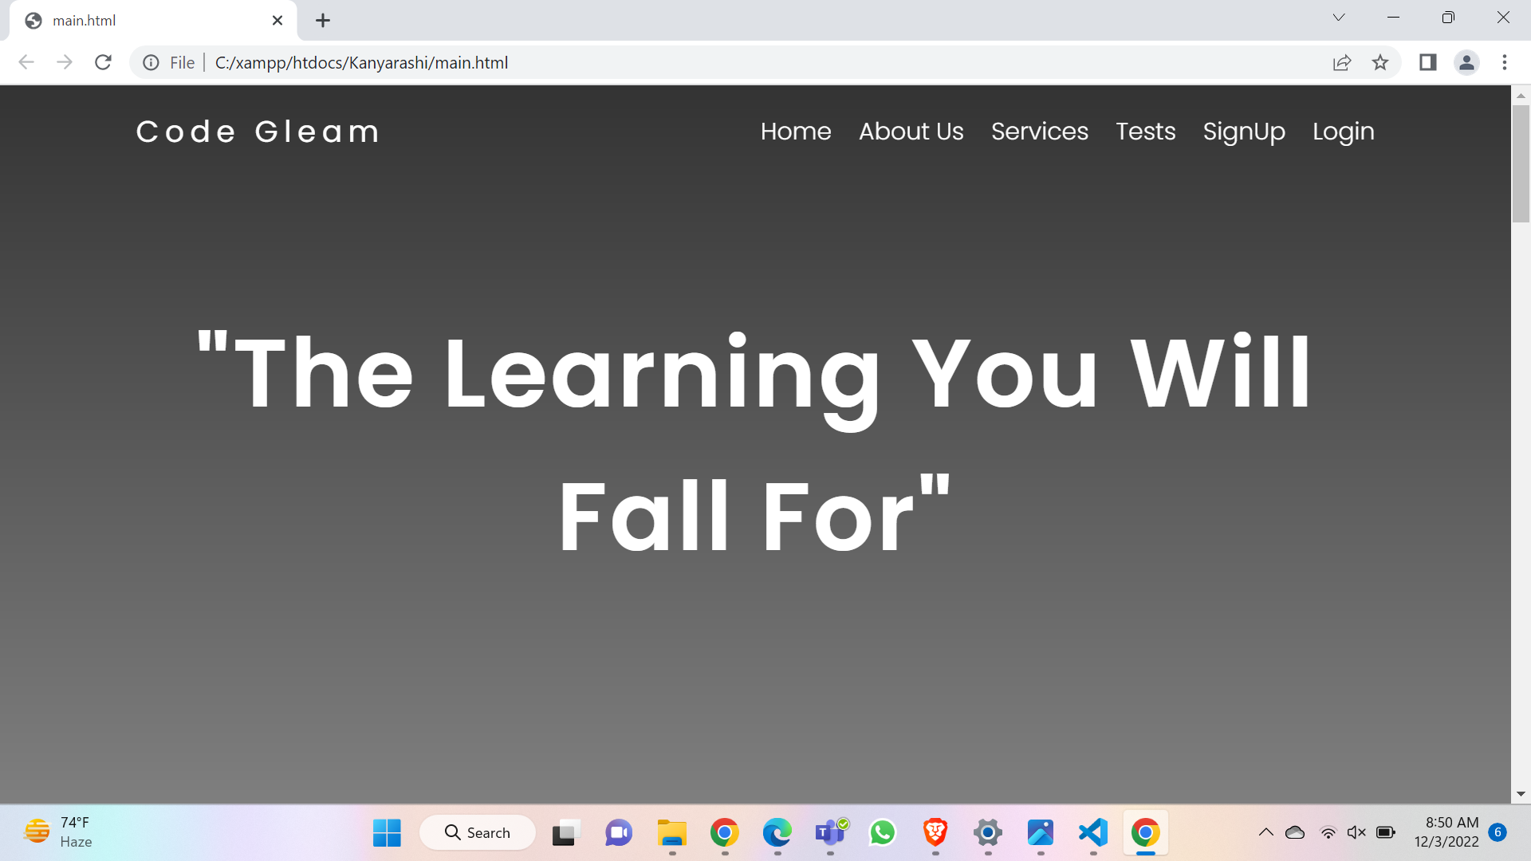
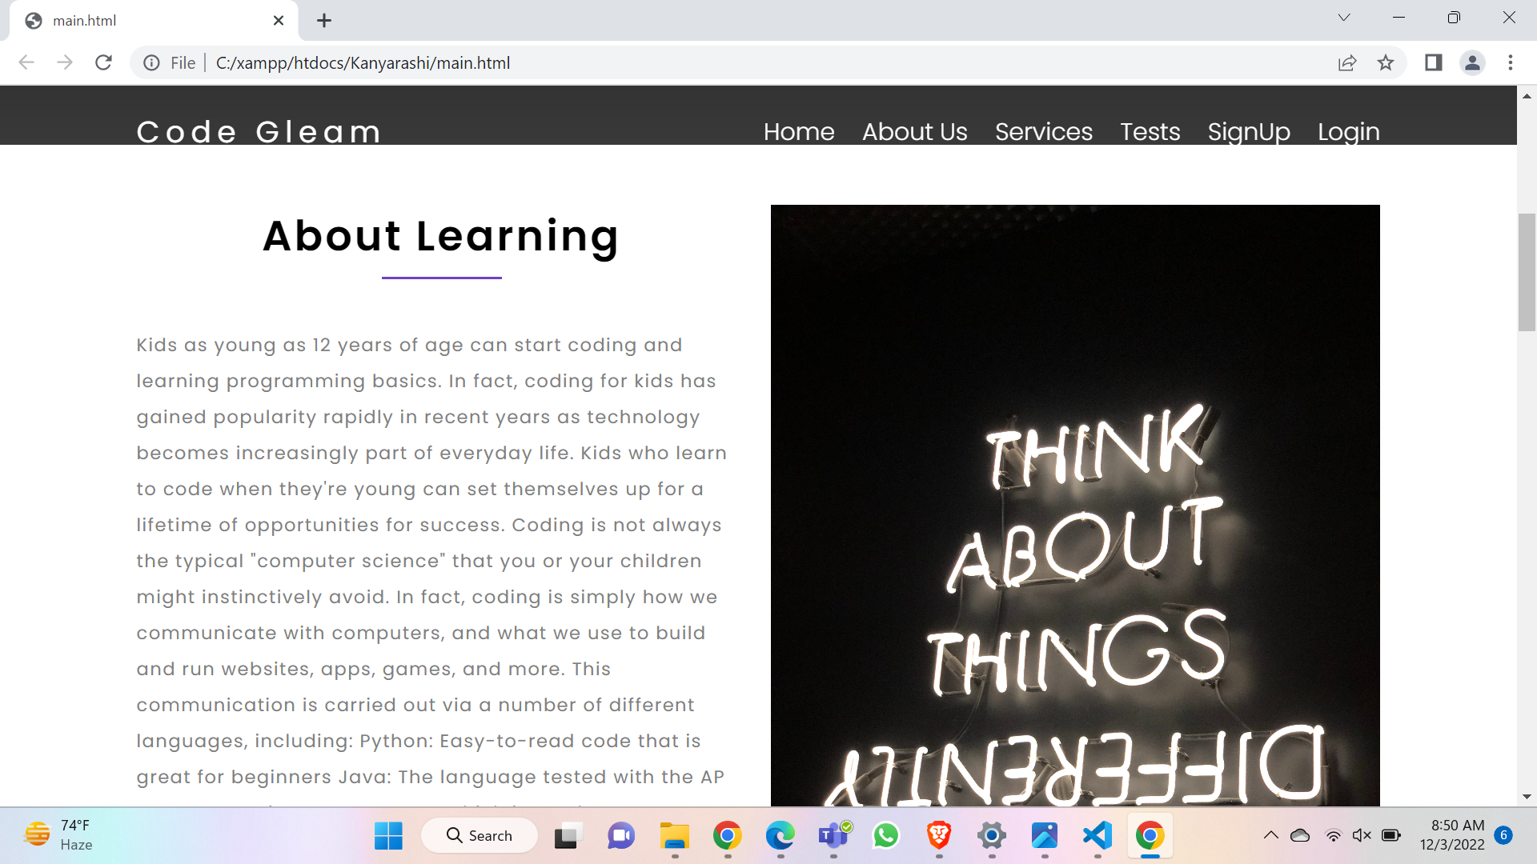
Result
DESC…

Slide 7
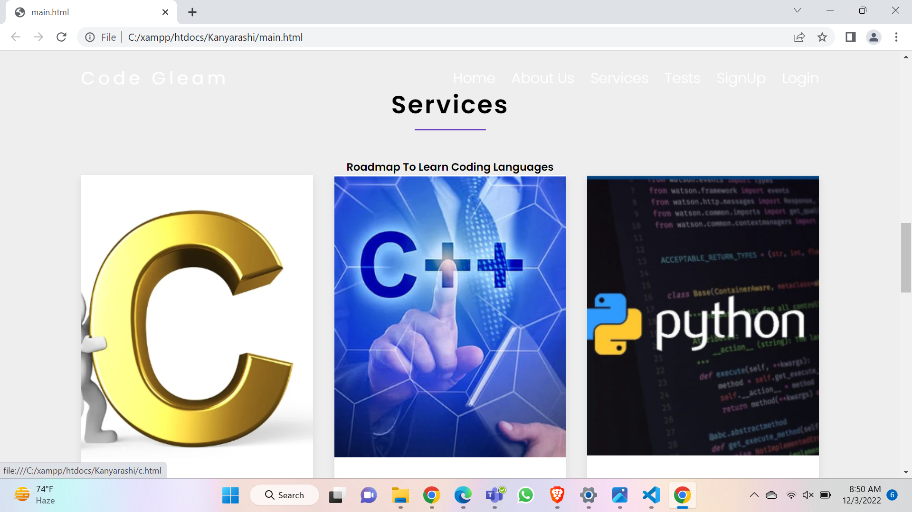
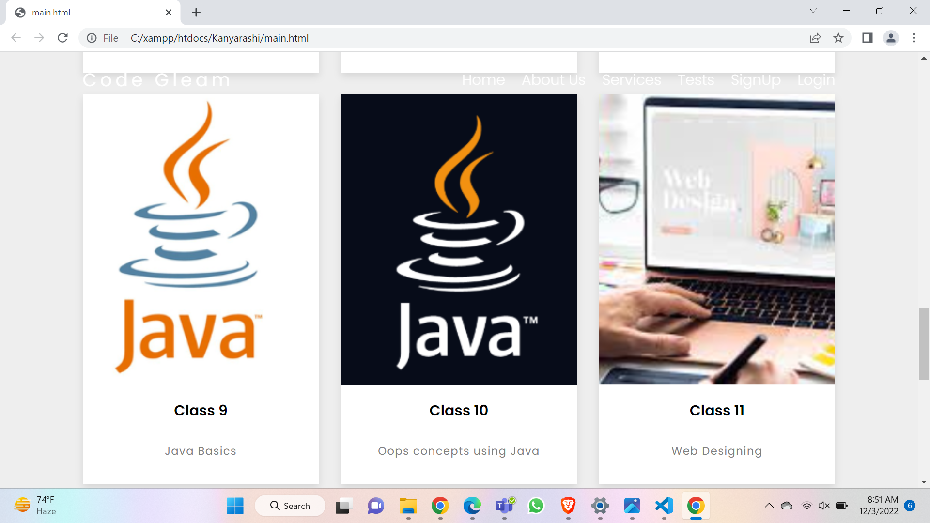
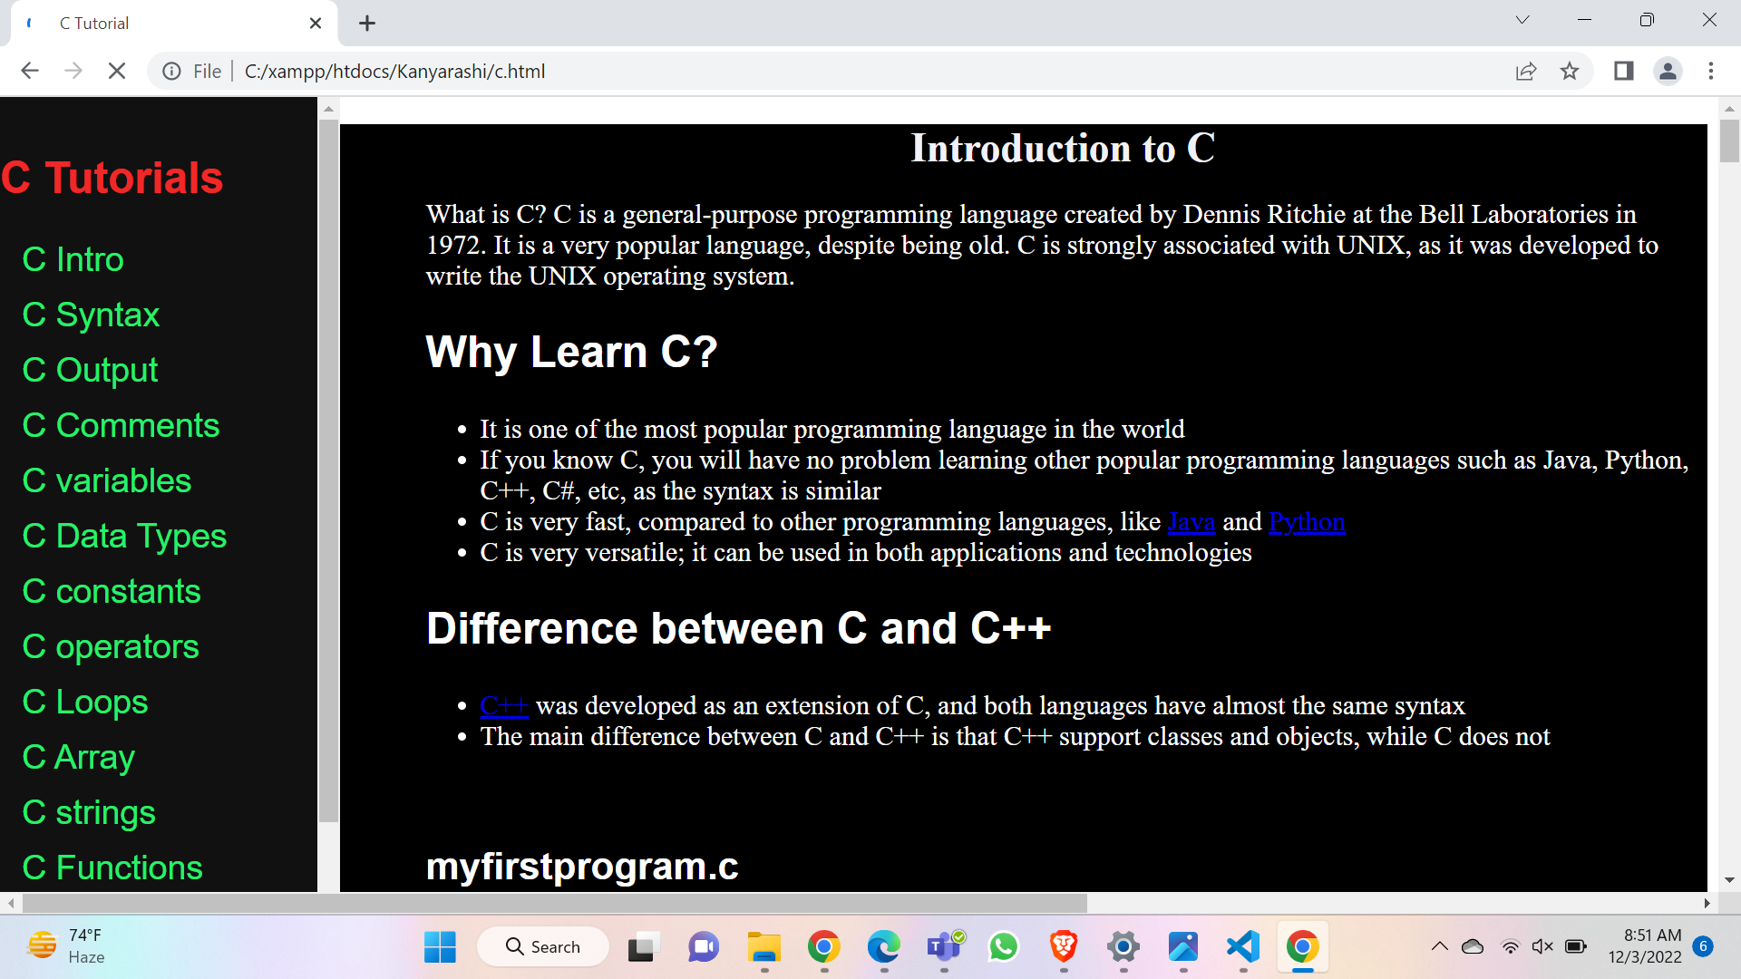

Slide 8
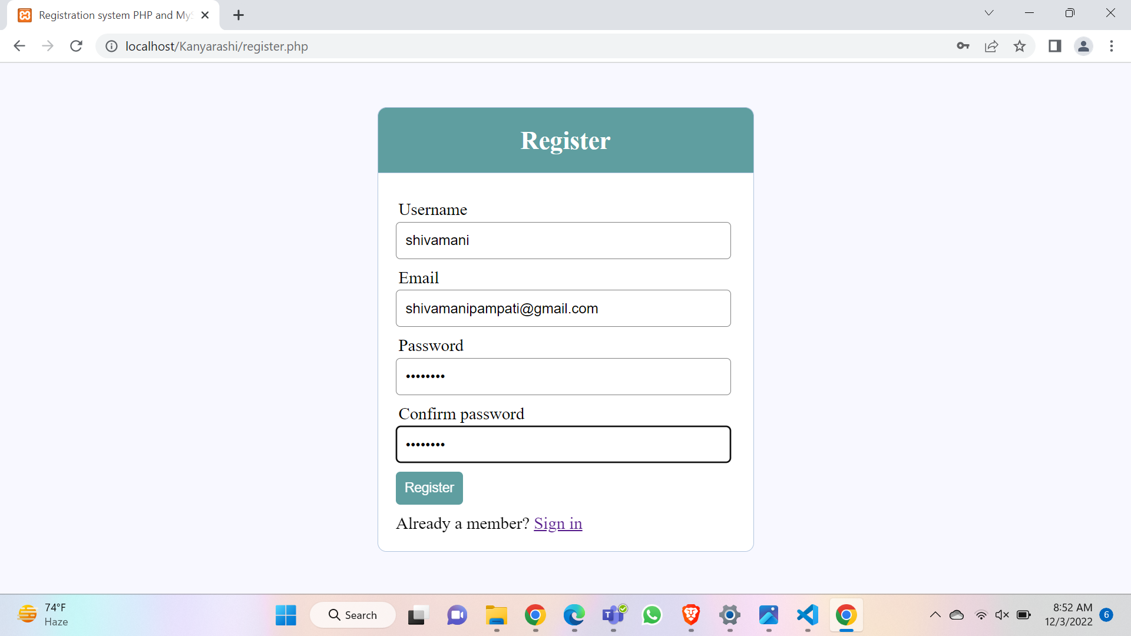
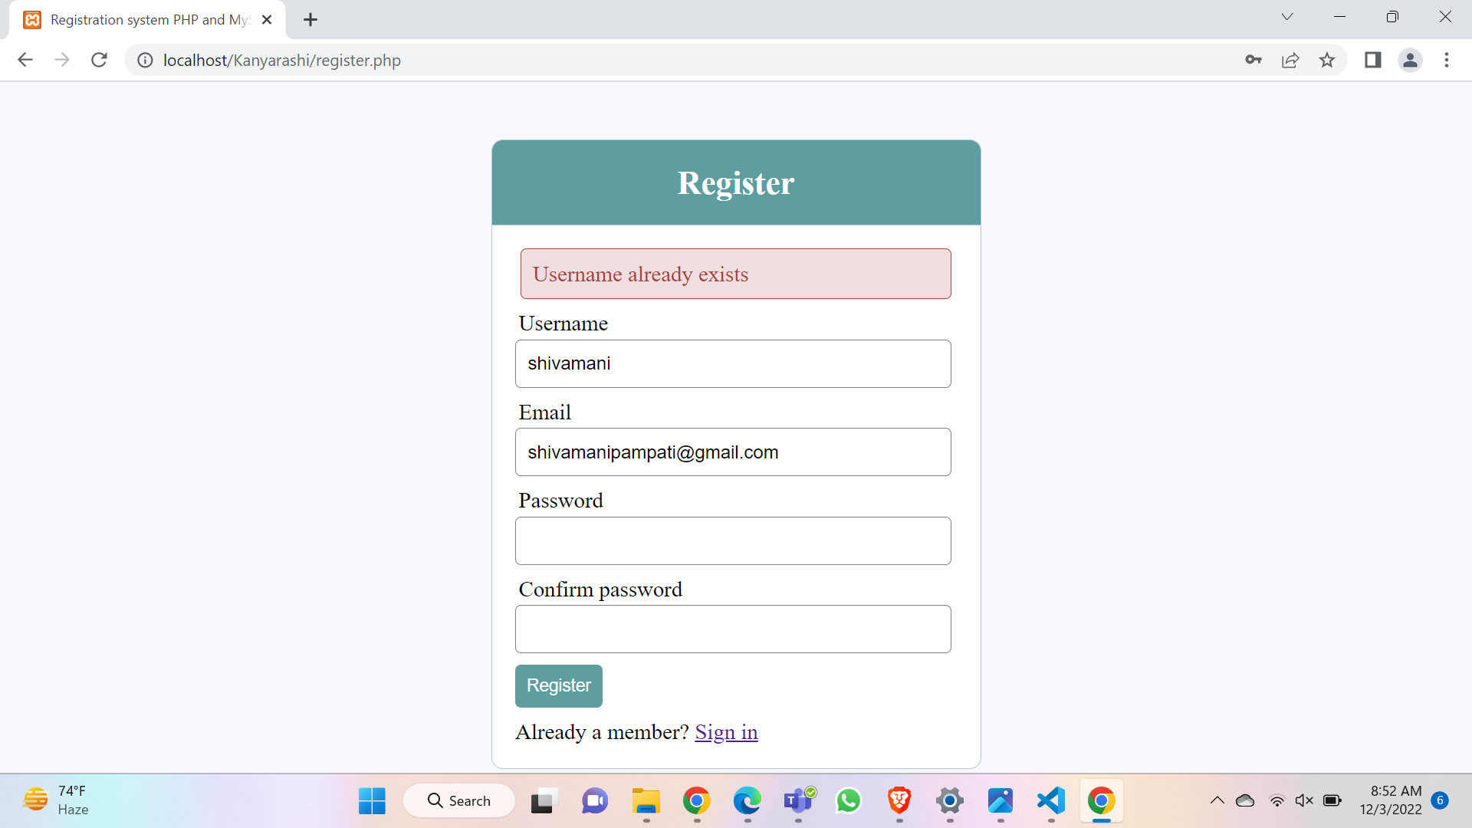
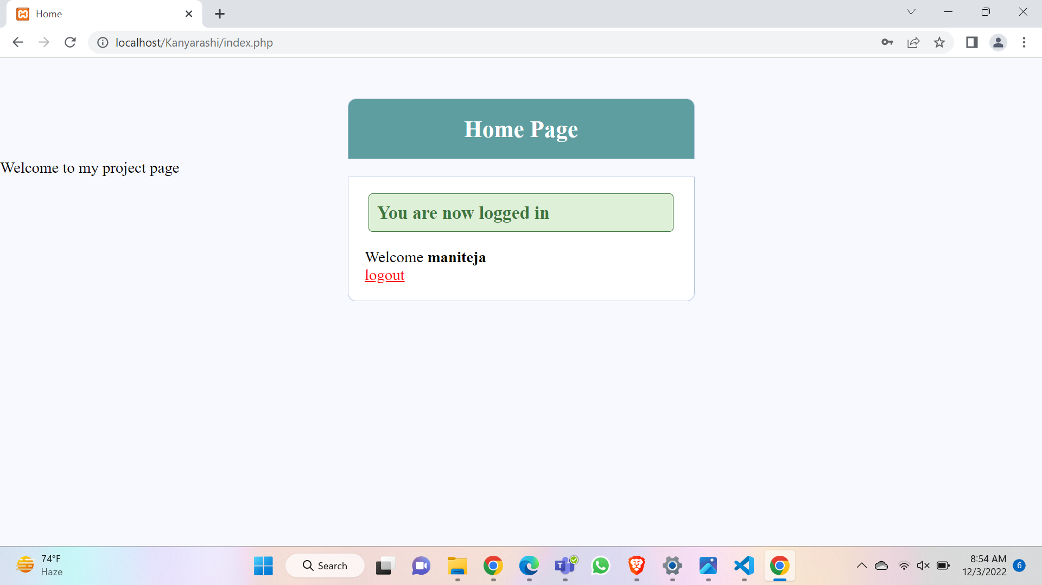
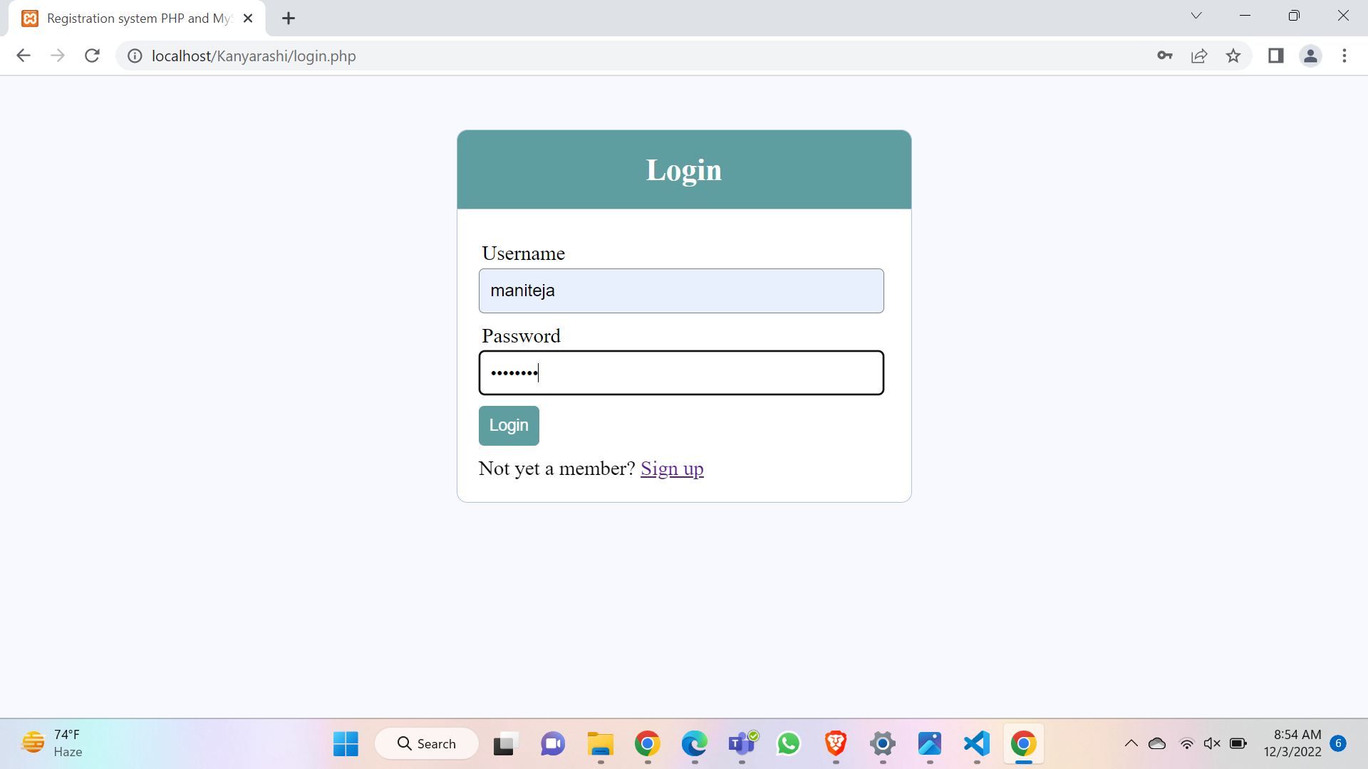

Slide 9
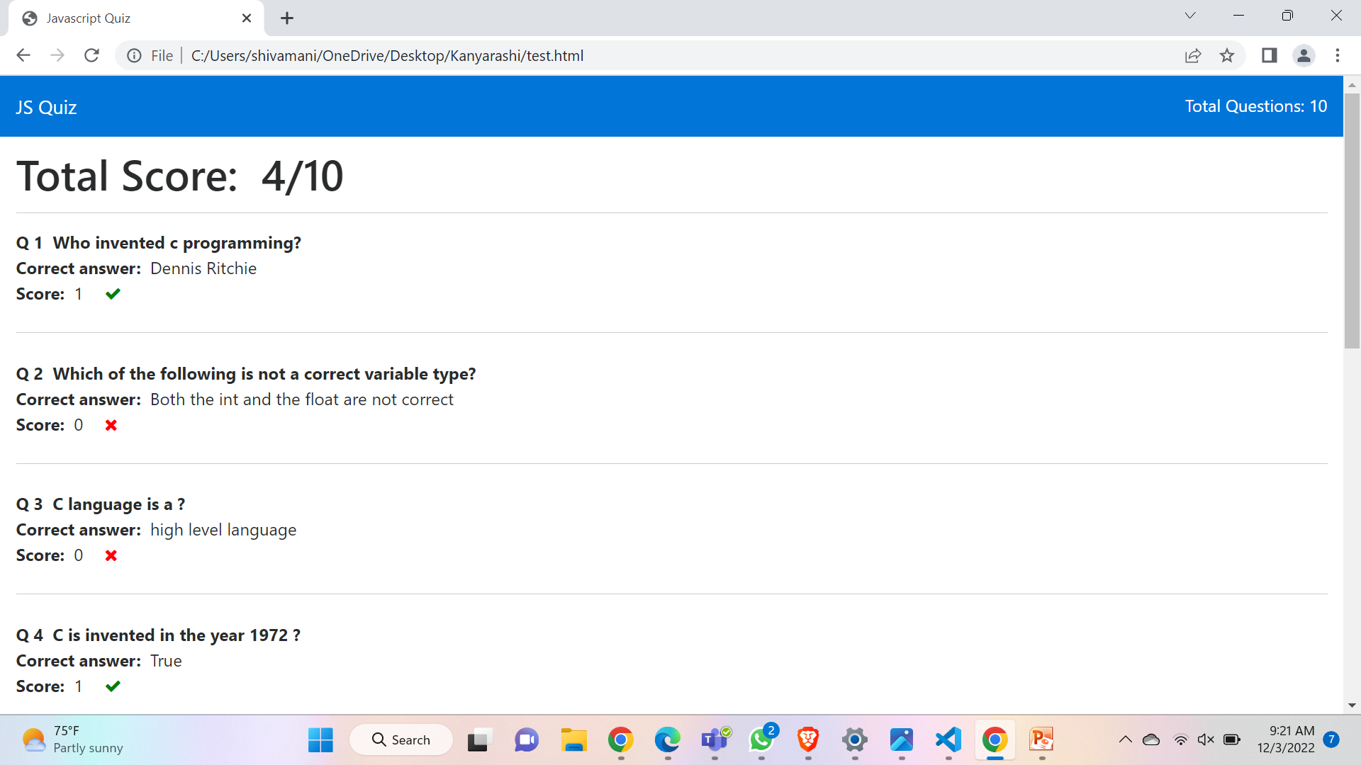
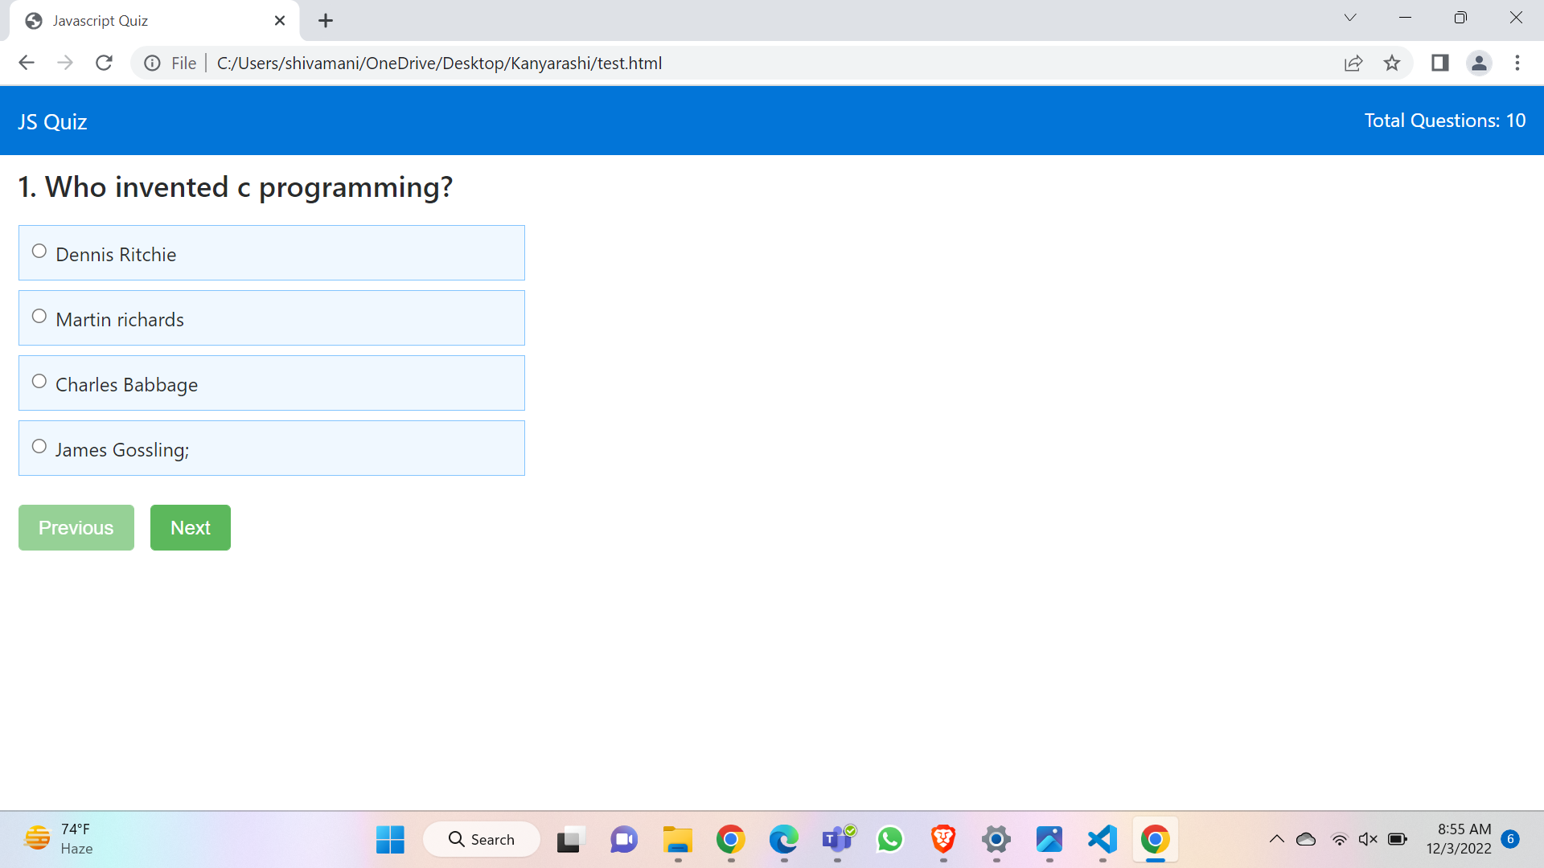

Slide 10
Future Scope
We can explain the concepts to the students by speech format so that more user count might increase.
Certificate can be provided for the pursued course.
Coding contests can be conducted to improve the skills of students.
Live classes can be introduced.
To make Learning intresting we can use animation videos.

